Slide 1

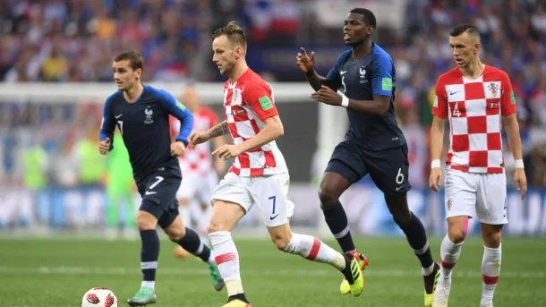
World cup matches
EXPLORATORY DATA ANALYSIS ON WORLD CUP MATCHES
BY ROHIT SUBRAMANIAM

Slide 2
agenda
BUSINESS/DATA QUESTIONS
PROJECT PIPELINE
CORRELATIONS
WINNING TEAMS
LINEAR REGRESSION RESULTS
SUMMARY
CONCLUSIONS AND FURTHER WORK

Slide 3
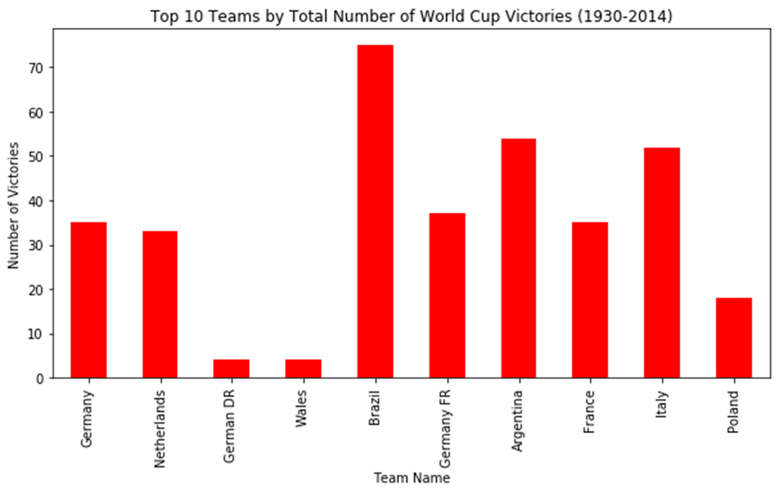
BUSINESS QUESTION
Most and least consistent performing teams throughout the world cup?
Data questionS
1. What are the characteristics of the dataset?
2. Which variables together has the strongest positive and negative relationships?
3. What are the trends between variables with the strongest positive and negative relationships?

Slide 4
PROJECT PIPELINE
Background context
Stakeholders
Business and data questions
Business and Data Answers
Imported world cup dataset
Data Analysis
Key Variable Selections
LINEAR REGRESSION MODELLING
CONCLUSIONS

Slide 5
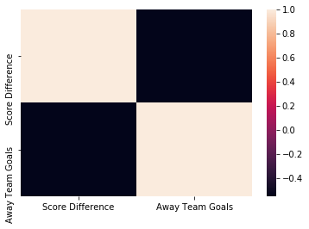
CORRELATIONS
Figure 1: Relationship strength between away team goals and score difference

Slide 6
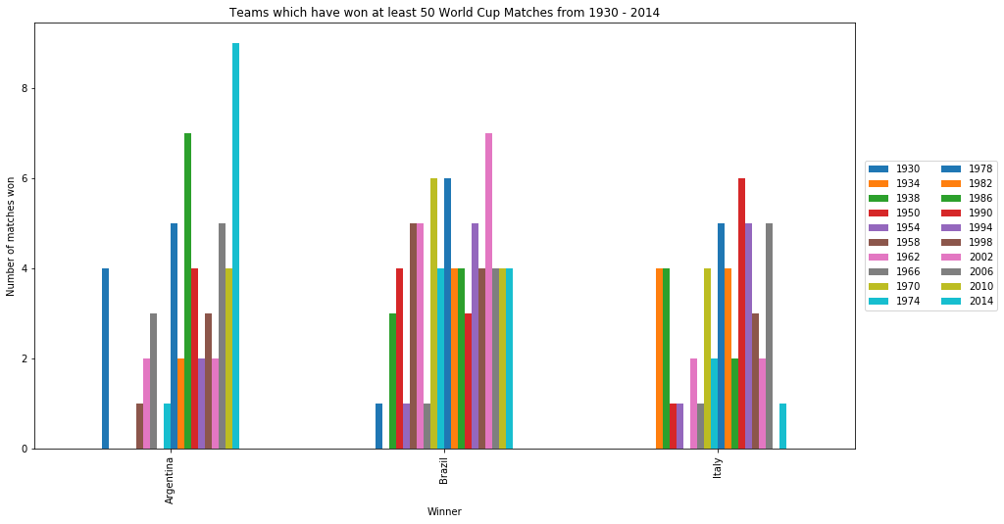
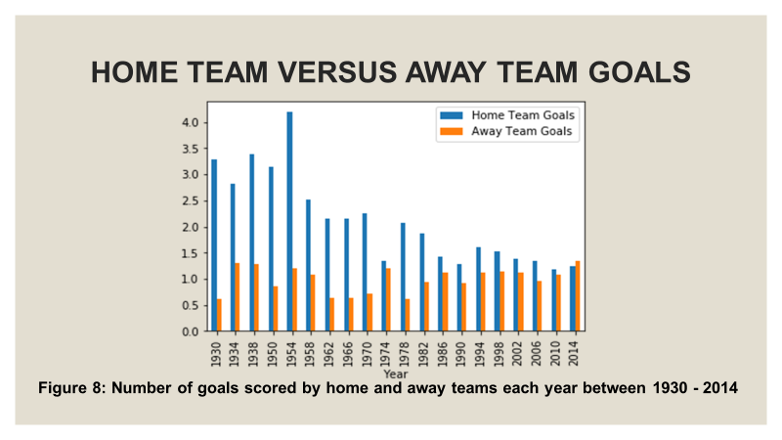
WINNING TEAMS
Figure 2: Top 3 teams
Figure 3: Teams ranked
Figure 4: Goal scoring trends

Slide 7
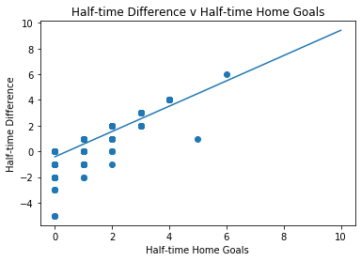
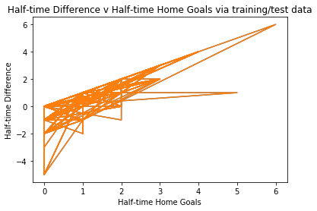
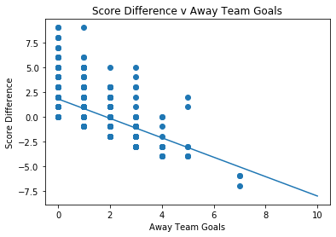
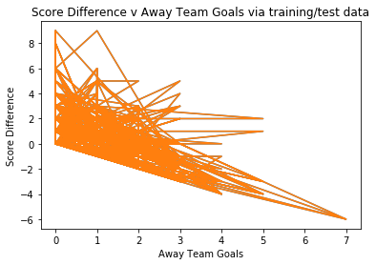
LINEAR REGRESSION RESULTS
Half-time Difference= 0.983 x Half-time Home Goals – 0.417
Half-time Difference= 0.951 x Half-time Home Goals – 0.391
Score Difference = -0.982 x Away Team Goals + 1.792
Score Difference = -0.974 x Away Team Goals + 1.790

Slide 8
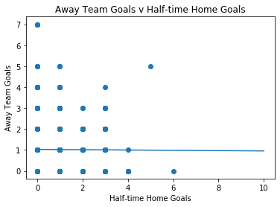
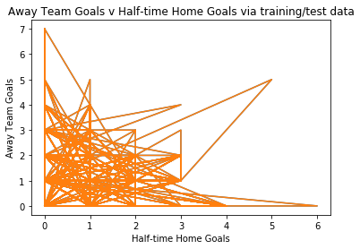
LINEAR REGRESSION RESULTS *
Away Team Goals = -0.007 x Half-time Home Goals + 1.027
Away Team Goals = - 0.022 x Half-time Home Goals + 1.048

Slide 9
SUMMARY
DATA
METHOD
OUTCOMES
* Data consists of both categorical and numerical variables.
* Imported world cup dataset
* Created score difference and half-time difference variables
* Used appropriate visual graphs to identify performance trends
* Used modelling to evaluate relationship strength between certain variables.
* Visual graphs provided insight on performance trends.
* Linear regression helped to understand relationship strength between certain variables.
* Data consists of 853 entries from 1930 to 2014.
* Only the variable ‘attendance’ has 2 null values.

Slide 10
CONCLUSIONS
Strongest positive correlation is between half time home goals and half-time difference.
Strongest negative correlation is between score difference and away team goals.
Most teams have won majority of their matches in 1974 and 2014.
Brazil, Argentina and Italy have been the top three performing teams across all world cup matches between 1930 - 2014.
FURTHER WORK
Apply other regression models to this data set.

